Slide 1

Pennant Technologies Private Limited
Introduction class

Slide 4
Application
An application, also referred to as an application program or application software, is a computer software package that performs a specific function directly for an end user or, in some cases, for another application.
An application can be self-contained or a group of programs.
The program is a set of operations that runs the application for the user.
Types of Java Applications:
standalone applications
web applications
enterprise applications
mobile applications

Slide 5
Types of Applications
Standalone applications: a program is run by seperate computer process without adding an existing files process is known as standalone applications.
it doesnot require operating systems process .
AWT and Swing are used to create standalone applications.
Web Applications: It is a client server software application which is run by client.
it includes mail,online retail sales , wikipedia information . servlets, jsp, jsf which are used to create web applications.
Enterprise Applications: it is related to middleware applications.
to enable software applications and hardware systems, we are using technologies and services across the enterprises.
these are mainly designed for corporate sides such as banking business systems.
mobile applications:
it is developed for run the mobile phones and tablets.

Slide 6
Types of software applications
Mobile Applications
Desktop GUI Applications
Web-based Applications
Enterprise Applications
Scientific Applications
Gaming Applications
Big Data technologies
Business Applications
Distributed Applications
Cloud-based Applications

Slide 7
Virtual Private Network
A VPN is a secure connection that can be made between a computer (such as a user's computer at home or on the road) and a protected or private corporate network (such as Lehigh's campus network), using an otherwise insecure public network (such as the Internet).
A virtual private network (VPN) is a technology that creates a safe and encrypted connection over a less secure network, such as the internet.
A Virtual Private Network is a way to extend a private network using a public network such as the internet.
The name only suggests that it is a Virtual “private network” i.e. user can be part of a local network sitting at a remote location.
It makes use of tunneling protocols to establish a secure connection.

Slide 8
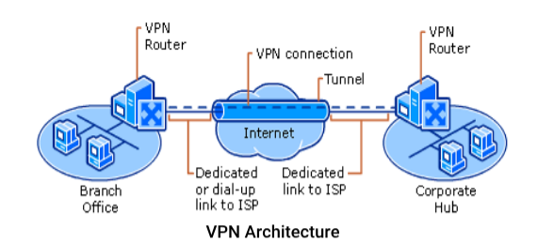

Slide 9
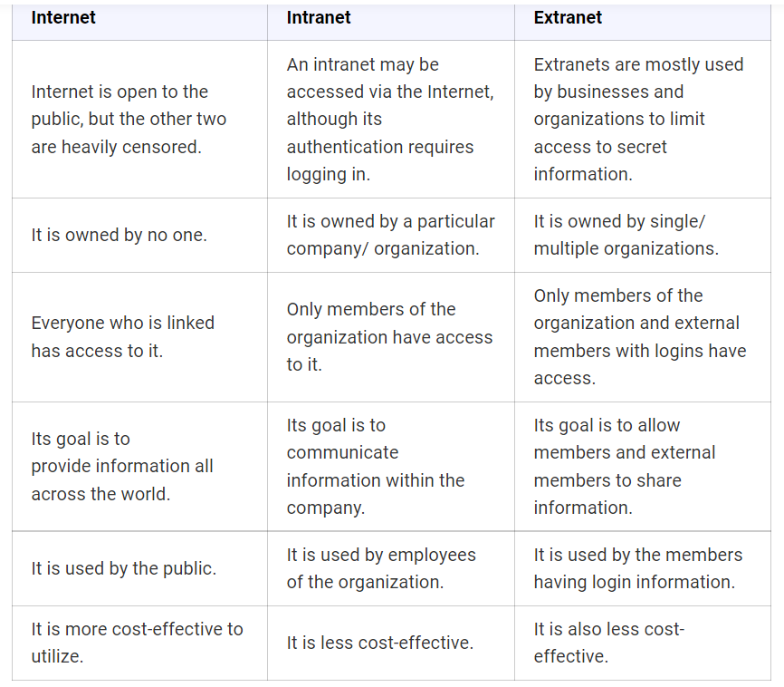

Slide 10
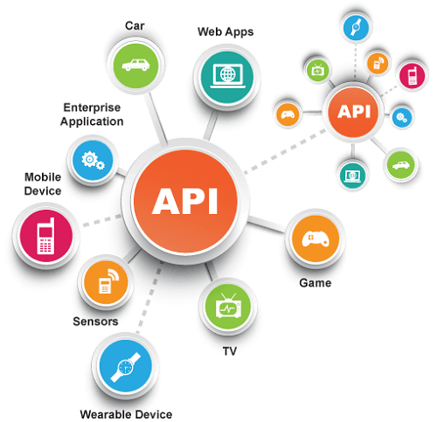

Slide 11
What Is Api And Why It Is Used?
An application can communicate with another application through an API, which stands for Application Programming Interface. You use an API every time you use an app like Facebook, send an instant message, or check the weather on your phone.
What Is Api And How It Works?
An application programming interface is known as an API. Two applications can communicate with each other using an API. As a result, an API is the messenger that delivers your request to the provider that you’re requesting it from, and then delivers the response back to you as a result.
Is Api Part Of Operating System?
The OS application programmer interfaces (APIs) are a key enabler for targeting independent software and seamless upgrades when the underlying hardware changes. Open systems promise significant cost reductions through this mechanism.
What Are The Functions Of Api?
An API is used for a specific purpose. An API acts as a virtual middleman, transferring information between two interfaces, such as a mobile app, and another. Information is routed to the right place using APIs, which connect different parts of a software platform.
What Is The Role Of Platform Application Programming Interface?
The API allows developers and third-party applications to interact with platform users in a variety of ways. The API allows developers and third-party applications to interact with, customize, and extend the functionality of a platform. The API allows developers and third-party applications to rewrite the platform’s functions.
Where Is Api Used?
APIs are used by web applications to connect the front-end with the back-end functionality and data that is important to the user. APIs are used by streaming services like Spotify and Netflix to distribute content. APIs are used by automotive companies like Tesla to update their software. APIs are used by others to unlock the data of third parties about cars.

Slide 12
Why Are Apis Used?
In order to perform a designed function, APIs are necessary to bring applications together so that they can share data and execute pre-defined processes together. In this role, developers are able to build new programmatic interactions between different applications people and businesses use on a daily basis, since they are the middle man.
What Api Means?
An API is a set of definitions and protocols for building and integrating applications. It is used to describe and describe how software is built and integrated.
What Is Api And Its Work?
API (Application Programming Interface) is essentially a gateway that allows software to communicate with other software – and defines how that communication takes place as well. API’s are essentially keys and maps that allow other software to be accessed.
What Is An Api Used For?
An API is an acronym for Application Programming Interface, which software uses to access data, server software, or other applications and has been around for quite some time. APIs are very versatile and can be used on web-based systems, operating systems, databases, and computer hardware.

Slide 13
How Does Api Request Work?
In an API, information is requested from a server and a response is received. Endpoints are the channels APIs use to communicate with each other and specify where a resource resides.
What Is The Api In Computer?
In computing, an API is a set of rules that describe how computers and applications communicate. An API sits between an application and a web server, acting as an intermediary layer between the two. In response to the API, the server sends the requested information to it.
What Are Some Examples Of Api?
APIs are used by Google to display relevant data from user search queries, such as weather.
The following is a sample of using XYZ to log in using Buffer’s social login.
You can pay with PayPal…
A Twitter bot that allows you to follow people on Twitter…
Booking a trip is a major part of travel.

